Slide 1
Home Credit Case Study:
Decision-Making for Loan Applications
from Clients without Prior Credit History
by: Sri Hartini
Virtual Internship Experience
Home Credit Indonesia
Rakamin Academy

Slide 2

The Problem
Individuals without prior credit history often face challenges in obtaining loans, making them vulnerable to untrustworthy lenders who exploit their financial vulnerability with very high interest rates.
Home Credit, driven by its mission to empower society and provide accessible and secure loan experiences, aims to extend its services to these underserved individuals. However, achieving this objective must be balanced with maintaining a sustainable business model.

Slide 3
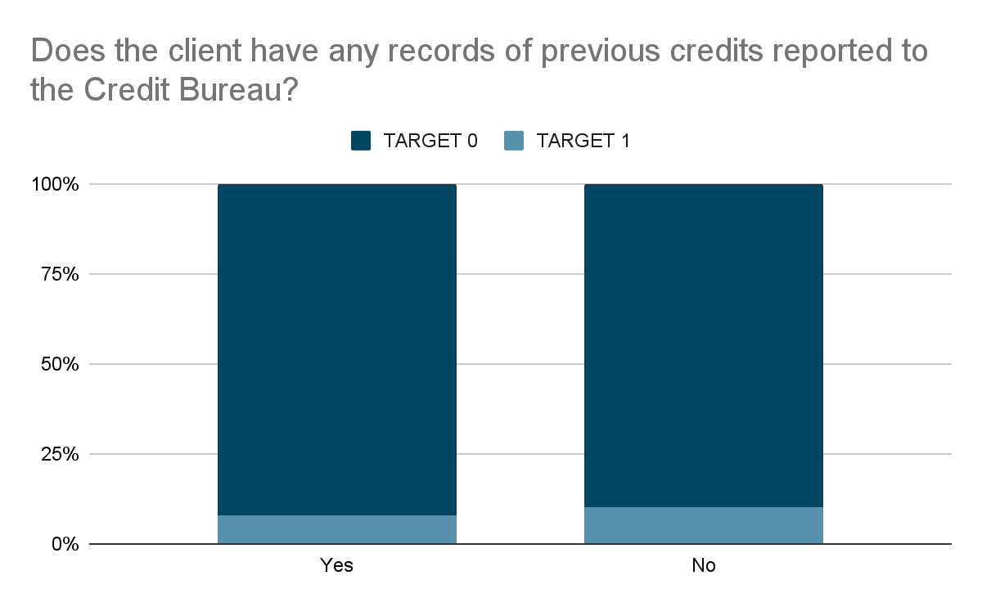
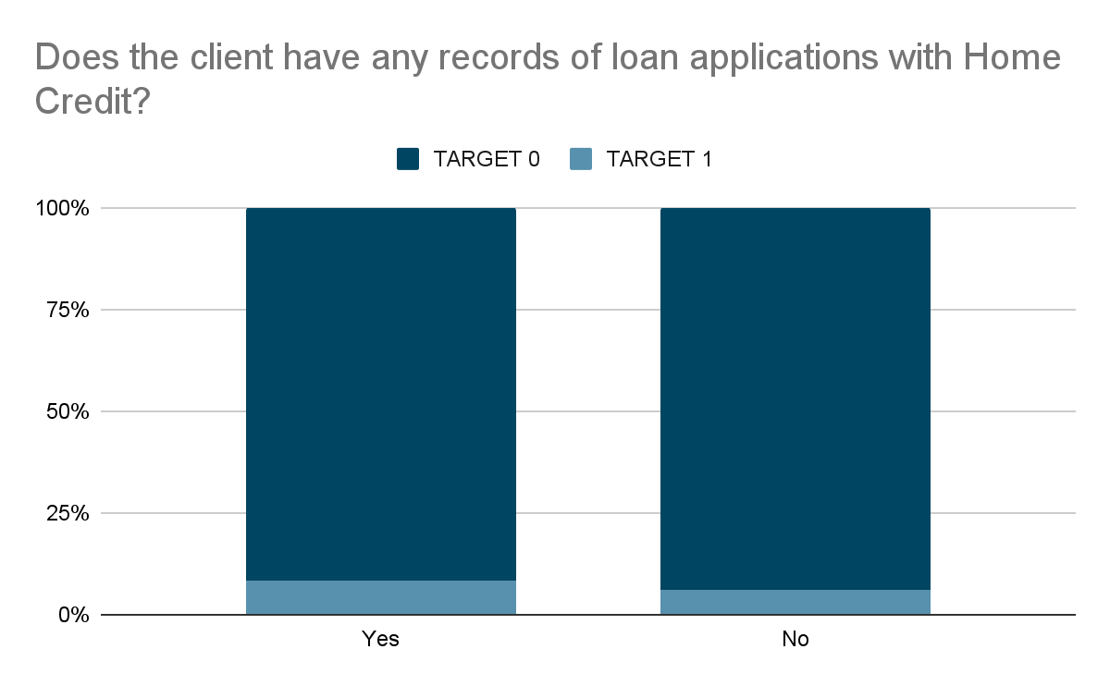
Based on our application data, the majority of our current customers have previously established credit, either recorded in the Bureau Credit or our previous application dataset. Surprisingly, there doesn't seem to be a noticeable difference in the ability to repay loans between individuals with prior credit history and those without.
Now, the question arises:
What characteristics should we consider when granting loans, particularly to individuals without prior credit history?

Slide 4
Dataset:
We are working with our current application dataset.
The dataset consists of 307,511 observations.
Each observation is uniquely identified by its unique ID called SK_ID_CURR.
The ability to pay back the loan is identified by the TARGET column, which has values of 0 and 1.
0 represents those who have no difficulty in paying back the loan.
1 represents those who face difficulties in paying back the loan.
Features:
There are 122 features in the dataset.
The features include SK_ID_CURR (unique ID) and the TARGET column.
The features also encompass demographic information about the client, the type of loan they applied for, and the loan amount.

Slide 5
The process (1/2)
The problem statement:
Finding the approach for making loan application decisions for clients without prior credit history
Step 1
Step 2
Step 3
Data Validation
Ensuring reasonable value range in columns
Identifying consistencies in data and missing value identification
Data Cleaning
Handling missing values
Addressing outliers
Feature Engineering
Encoding categorical features
Normalizing numerical features
Creating new features based on existing ones

Slide 6
The process (2/2)
Step 4
Step 5
Step 6
Feature Selection
Using Random Forest (top 15 features)
Using SelectKBest (top 20 features)
Combining the selected features from both methods (total of 31 features)
Model Evaluation
Decision Tree and Logistic Regression
Evaluating using ROC-AUC score
Choosing Logistic Regression as the final model due to better performance in identifying default loans
Model Interpretation and Further Analysis
Applying the Decile Methodology for interpretation and analysis

Slide 7
The result
Top three significant features:
Age at the time of the most recent registration change
Time elapsed since the client's last registration change
Client's age
Other relevant features for evaluating loan applications include:
Years of current employment
Loan type applied for
Educational background
Logistic Regression
Achieved an accuracy of 73.42% (measured by ROC-AUC score)
Further analysis needed to adjust model behavior:
ML models typically use 0.5 as the threshold to differentiate between target classes (0 and 1)
Decile methodology can be applied to test data to assess the percentage of successful predictions and avoid bad loans
Step 7

Slide 8
Optimizing Credit Decision-Making: A Strategic Approach
Profit Maximization
Synergizing Profitability and Market Expansion
73% of good loans predicted correctly
62% of bad loans predicted correctly
threshold for loan approval probability: 0.91
83% of good loans predicted correctly
48% of bad loans predicted correctly
threshold for loan approval probability: 0.88

Slide 9
The model in this project is built using static loan application data, incorporating factors such as client's age, employment status, and more.
The model uses a modified threshold for defining a "good loan" to provide insights and aid Home Credit in decision-making, particularly for clients without any credit history.

Slide 10
References
SKILLCATE. "Credit Scoring Project using Machine Learning | Risk Modelling | Logistic Regression | ML Project#1." YouTube, 2021.
DeepNeuron. "How to Interpret Logistic Regression model output in Python?" YouTube, 2022.
StatQuest with Josh Starmer. "Logistic Regression Details Pt1: Coefficients." YouTube, 2018.
Dhruv Narayanan. "Home Credit Default Risk (Part 2): Feature Engineering and Modelling-I." Medium, 2021.
Bruce Yang ByFinTech. "End-to-End Guide to Building a Credit Scorecard Using Machine Learning." Medium, 2022.
Home Credit Group. "Home Credit Default Risk." Kaggle, 2018.
Detailed code and analysis can be found on my GitHub through this link: → ___CLICK HERE___

